Slide 1
CNNs
The Data Bootcamp |
<DATE GOES HERE>

Slide 2

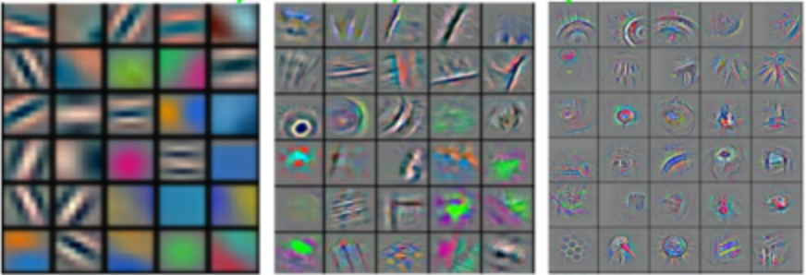
Convolutional Neural Networks
Spatial Features
Bus
Car
...
Image
Labels

Slide 3

Convolutional Neural Networks
Image Src: https://www.mathworks.com/discovery/convolutional-neural-network.html

Slide 4
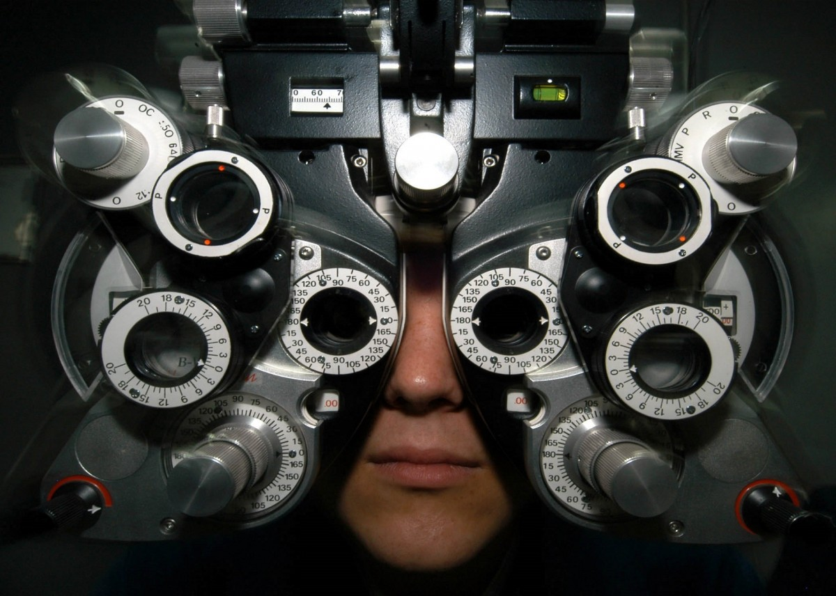
CNN Filters

Slide 5
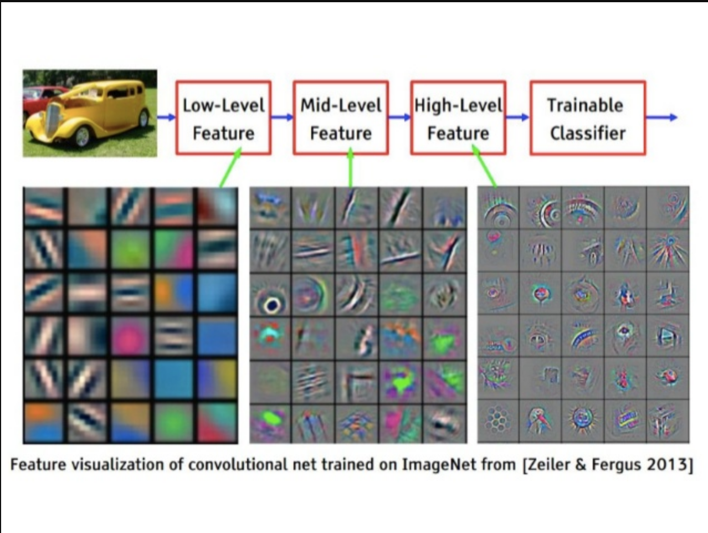
CNN Filters

Slide 6
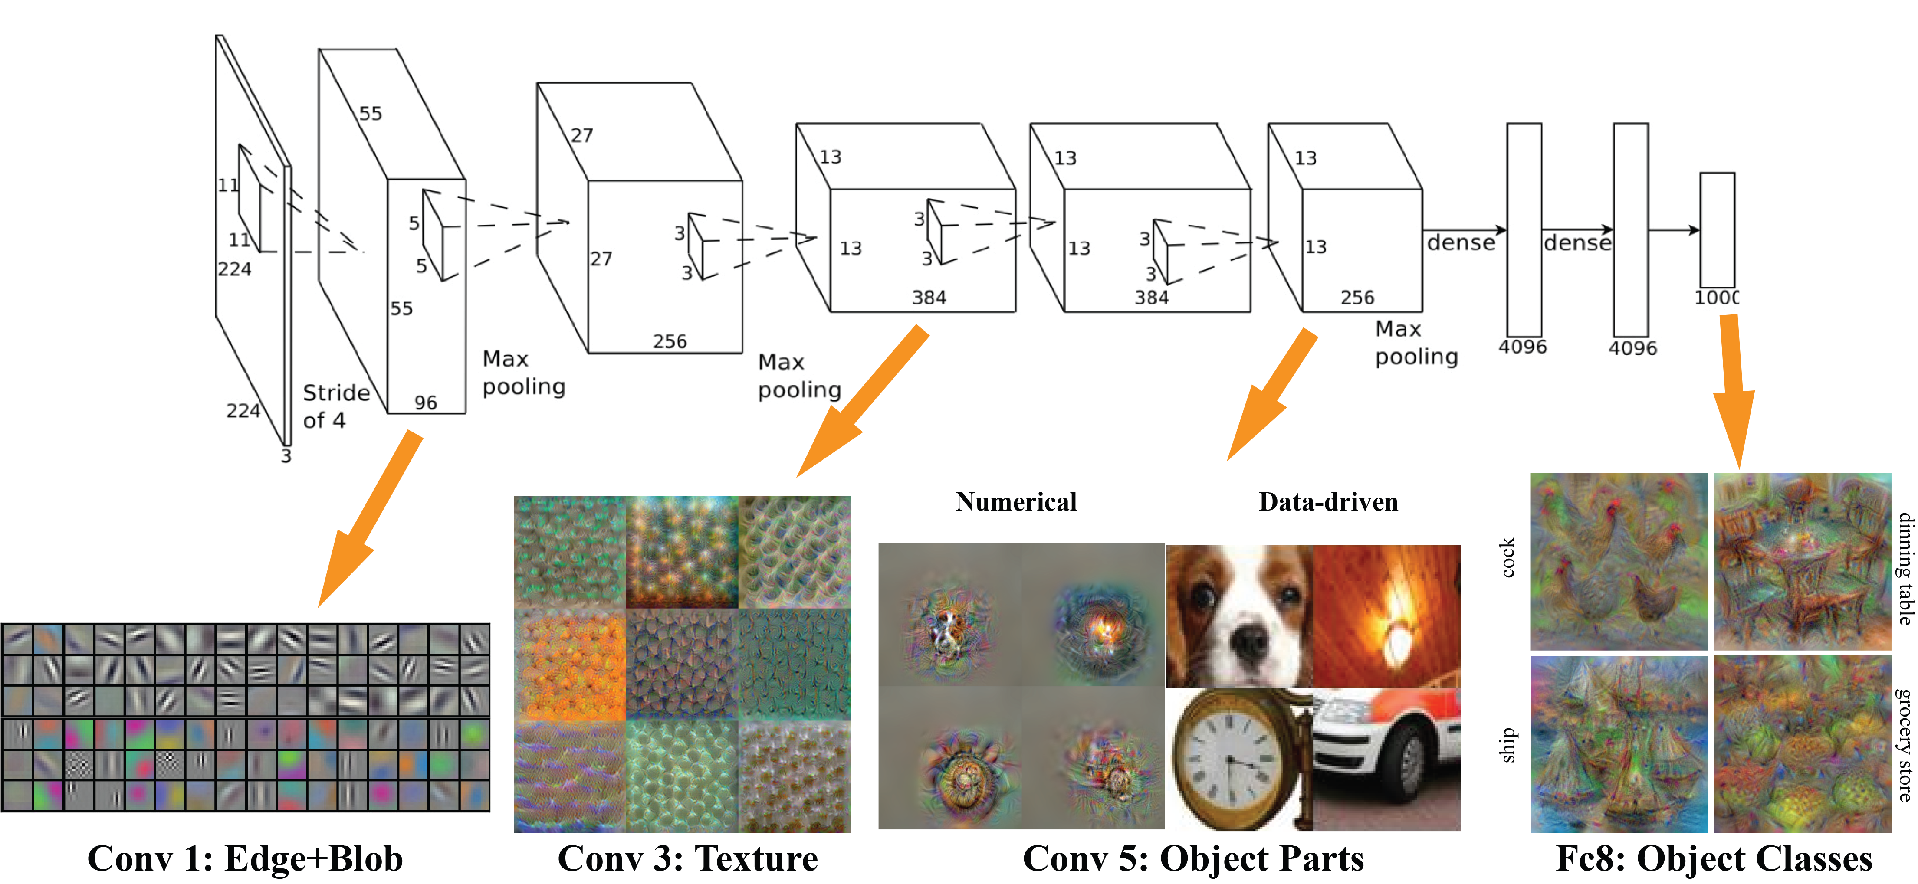
CNN Filters

Slide 7
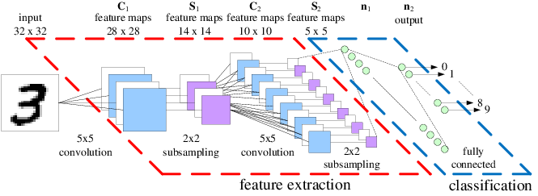
CNN Architecture

Slide 8
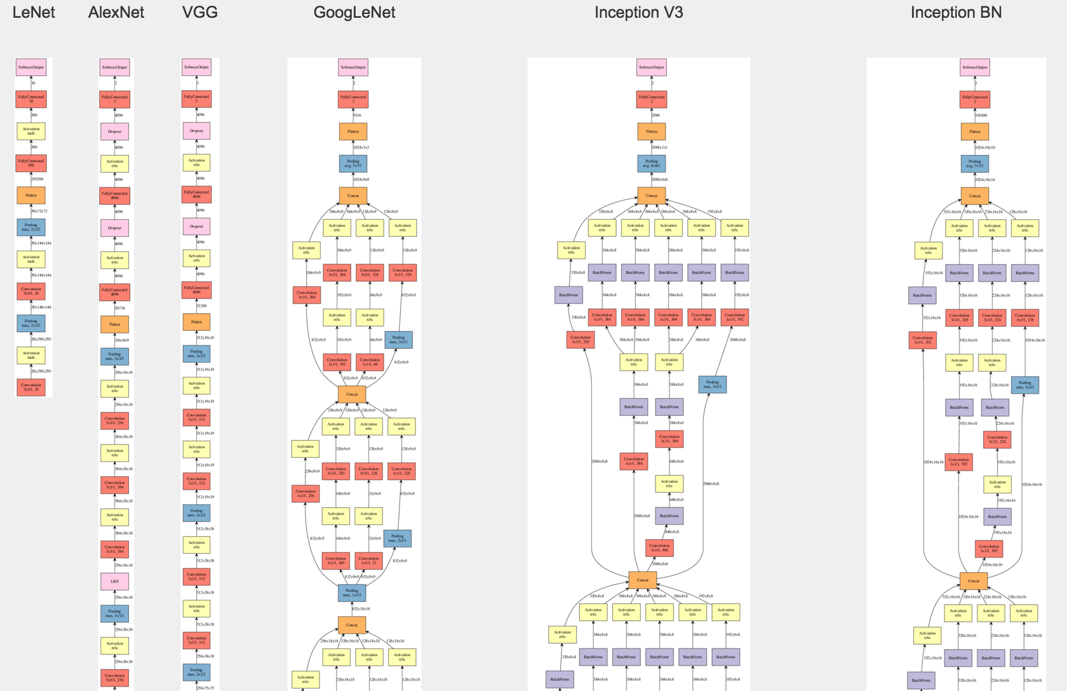
Famous CNN Architectures

Slide 9
Conv2D
Notes:
It’s important to keep in mind why you joined this class. Let’s talk about your goals.

Slide 10
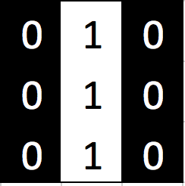
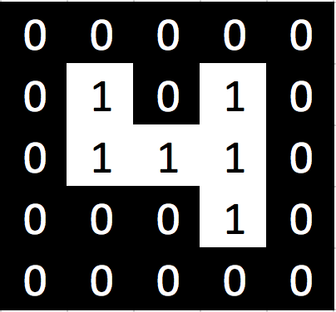
Conv2D
0 * 0 = 0
0
Filter
Multiply
Image

Slide 11
Conv2D
1 * 0 = 0
0 | 0
Filter
Multiply
Image

Slide 12
Conv2D
0 * 0 = 0
0 | 0 | 0
Filter
Multiply
Image

Slide 13
Conv2D
0 * 0 = 0
0 | 0 | 0
0
Filter
Multiply
Image

Slide 14
Conv2D
1 * 1 = 1
0 | 0 | 0
0
1
Filter
Multiply
Image

Slide 15
Conv2D
0 * 0 = 0
0 | 0 | 0
0 | 1 | 0
Filter
Multiply
Image

Slide 16
Conv2D
0 * 0 = 0
0 | 0 | 0
0 | 1 | 0
0
Filter
Multiply
Image

Slide 17
Conv2D
1 * 1 = 1
0 | 0 | 0
0 | 1 | 0
0 | 1
Filter
Multiply
Image

Slide 18
Conv2D
0 * 1 = 0
0 | 0 | 0
0 | 1 | 0
0 | 1 | 0
Filter
Multiply
Image

Slide 19
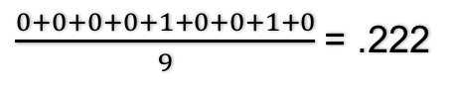
Conv2D
0 | 0 | 0
0 | 1 | 0
0 | 1 | 0
Filter
Multiply
$\frac{0+0+0+0+1+0+0+1+0}{9}$ = .222
Normalize
Image

Slide 20
Conv2D
 | .222
0 | 0 | 0
0 | 1 | 0
0 | 1 | 0
Filter
Multiply
$\frac{0+0+0+0+1+0+0+1+0}{9}$ = .222
Normalize
Filter Output

Slide 21
Conv2D Stride
0 | 0 | 0
0 | 1 | 0
0 | 1 | 0
Filter
Multiply
Image

Slide 22
Conv2D Stride
0 | 0 | 0
0 | 0 | 0
0 | 1 | 0
Filter
Multiply
Image

Slide 23
Conv2D Stride
0 | 0 | 0
0 | 1 | 0
0 | 1 | 0
Filter
Multiply
Image

Slide 24
Conv2D Stride
0 | 1 | 0
0 | 1 | 0
0 | 0 | 0
Filter
Multiply
Image

Slide 25
Conv2D Stride
0 | 0 | 0
0 | 1 | 0
0 | 0 | 0
Filter
Multiply
Image

Slide 26
Conv2D Stride
0 | 1 | 0
0 | 1 | 0
0 | 1 | 0
Filter
Multiply
Image

Slide 27
Conv2D Stride
0 | 1 | 0
0 | 0 | 0
0 | 0 | 0
Filter
Multiply
Image

Slide 28
Conv2D Stride
0 | 1 | 0
0 | 0 | 0
0 | 0 | 0
Filter
Multiply
Image

Slide 29
Conv2D Stride
0 | 1 | 0
0 | 1 | 0
0 | 0 | 0
Filter
Multiply
Image

Slide 30
Conv2D
 | .222
0 | 0 | 0
0 | 1 | 0
0 | 1 | 0
Filter
Multiply
$\frac{0+0+0+0+1+0+0+1+0}{9}$ = .222
Normalize
Filter Output

Slide 31
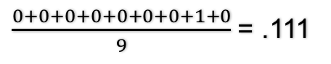
Conv2D
 | .222 | .111
0 | 0 | 0
0 | 0 | 0
0 | 1 | 0
Filter
Multiply
$\frac{0+0+0+0+0+0+0+1+0}{9}$ = .111
Normalize
Filter Output

Slide 32
Conv2D
 | .222 | .111 | .222
0 | 0 | 0
0 | 1 | 0
0 | 1 | 0
Filter
Multiply
$\frac{0+0+0+0+1+0+0+1+0}{9}$ = .222
Normalize
Filter Output

Slide 33
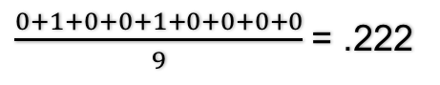
Conv2D
 | .222 | .111 | .222
 | .222
0 | 1 | 0
0 | 1 | 0
0 | 0 | 0
Filter
Multiply
$\frac{0+1+0+0+1+0+0+0+0}{9}$ = .222
Normalize
Filter Output

Slide 34
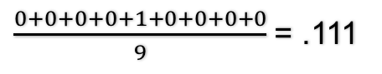
Conv2D
 | .222 | .111 | .222
 | .222 | .111
0 | 0 | 0
0 | 1 | 0
0 | 0 | 0
Filter
Multiply
$\frac{0+0+0+0+1+0+0+0+0}{9}$ = .111
Normalize
Filter Output

Slide 35
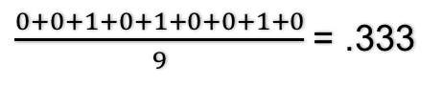
Conv2D
 | .222 | .111 | .222
 | .222 | .111 | .333
0 | 1 | 0
0 | 1 | 0
0 | 1 | 0
Filter
Multiply
$\frac{0+0+1+0+1+0+0+1+0}{9}$ = .333
Normalize
Filter Output

Slide 36
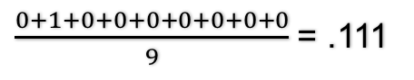
Conv2D
 | .222 | .111 | .222
 | .222 | .111 | .333
 | .111
0 | 1 | 0
0 | 0 | 0
0 | 0 | 0
Filter
Multiply
$\frac{0+1+0+0+0+0+0+0+0}{9}$ = .111
Normalize
Filter Output

Slide 37
Conv2D
 | .222 | .111 | .222
 | .222 | .111 | .333
 | .111 | .111
0 | 1 | 0
0 | 0 | 0
0 | 0 | 0
Filter
Multiply
$\frac{0+1+0+0+0+0+0+0+0}{9}$ = .111
Normalize
Filter Output

Slide 38
Conv2D
 | .222 | .111 | .222
 | .222 | .111 | .333
 | .111 | .111 | .222
0 | 1 | 0
0 | 1 | 0
0 | 0 | 0
Filter
Multiply
$\frac{0+1+0+0+1+0+0+0+0}{9}$ = .222
Normalize
Filter Output

Slide 39
Conv2D
Edges?
?
 | .222 | .111 | .222
 | .222 | .111 | .333
 | .111 | .111 | .222
Filter
Filter Output

Slide 40
Conv2D Stride
Extend/Pad Image
0 | 0 | 0
0 | 0 | 0
0 | 0 | 0
Filter
Multiply
Image

Slide 41
Conv2D
0 | 0 | 0 | 0 | 0
0 | .222 | .111 | .222 | 0
0 | .222 | .111 | .333 | 0
0 | .111 | .111 | .222 | 0
0 | 0 | 0 | .111 | 0
Filter
Filter Output

Slide 42
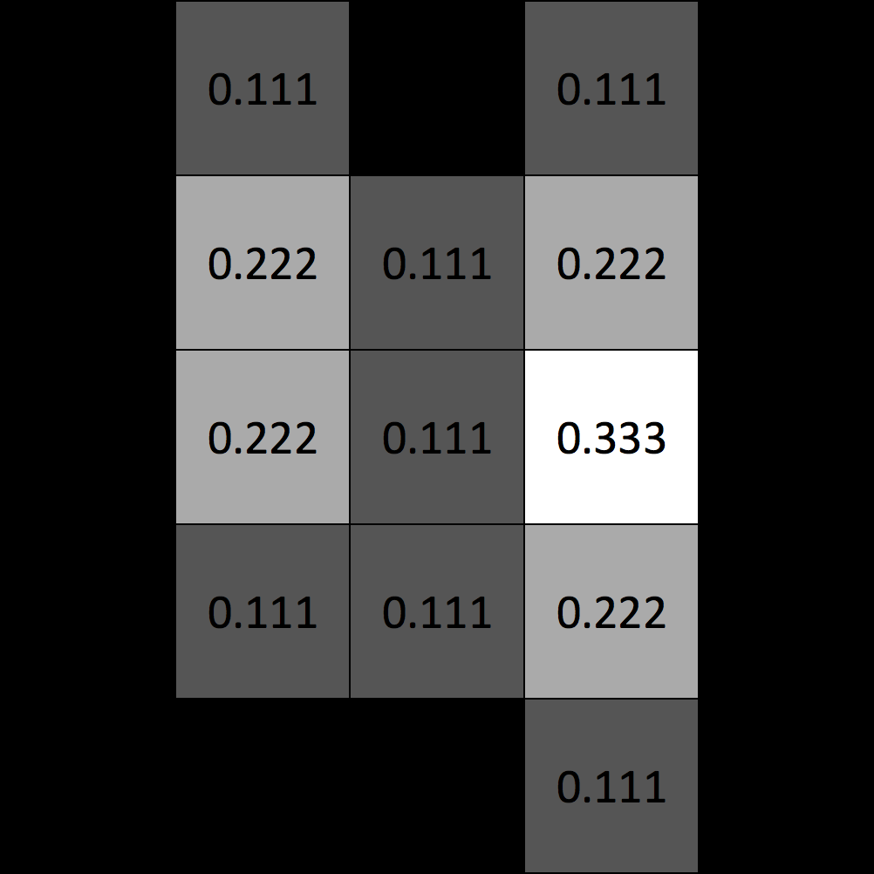
Conv2D Output
Best Match
for this filter
Filter
Conv2D Output

Slide 43
Max Pooling
Notes:
It’s important to keep in mind why you joined this class. Let’s talk about your goals.

Slide 44
MaxPooling
0 | 0 | 0 | 0 | 0
0 | .222 | .111 | .222 | 0
0 | .222 | .111 | .333 | 0
0 | .111 | .111 | .222 | 0
0 | 0 | 0 | .111 | 0
Max
.222
Pooling Output
Pooling Window = 3x3
Stride = 2

Slide 45
MaxPooling
0 | 0 | 0 | 0 | 0
0 | .222 | .111 | .222 | 0
0 | .222 | .111 | .333 | 0
0 | .111 | .111 | .222 | 0
0 | 0 | 0 | .111 | 0
Max
.222 | .333
Pooling Output
Pooling Window = 3x3
Stride = 2

Slide 46
MaxPooling
0 | 0 | 0 | 0 | 0
0 | .222 | .111 | .222 | 0
0 | .222 | .111 | .333 | 0
0 | .111 | .111 | .222 | 0
0 | 0 | 0 | .111 | 0
.222 | .333
.222
Max
Pooling Output
Pooling Window = 3x3
Stride = 2

Slide 47
MaxPooling
0 | 0 | 0 | 0 | 0
0 | .222 | .111 | .222 | 0
0 | .222 | .111 | .333 | 0
0 | .111 | .111 | .222 | 0
0 | 0 | 0 | .111 | 0
.222 | .333
.222 | .333
Max
Pooling Output
Pooling Window = 3x3
Stride = 2

Slide 48
Questions / Discussion
Notes:
It’s important to keep in mind why you joined this class. Let’s talk about your goals.

